Slide 1
Design Practice II

Slide 2
OOP and Data Model

Slide 3
OOP design
This step happens in the Application layer or Business logic layer
A easy tips
All nouns are classes, all verbs are method, all attributes are private members.
How the objects are created? Object factory?
Singleton Object creation?

Slide 4
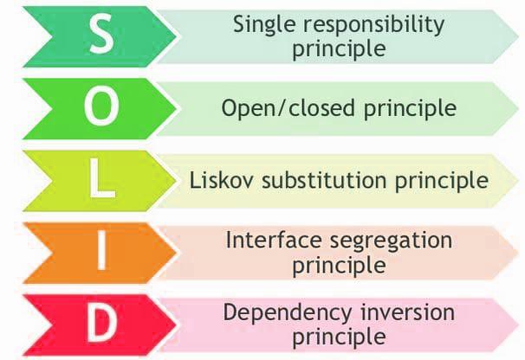

Slide 5
Single Responsibility Principle
Class should have only one reason to change. It can be changed multiple time over the period of time but within the context of that class. In simple word, it should have the contextual reason to change in the class.

Slide 6
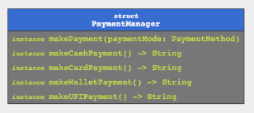
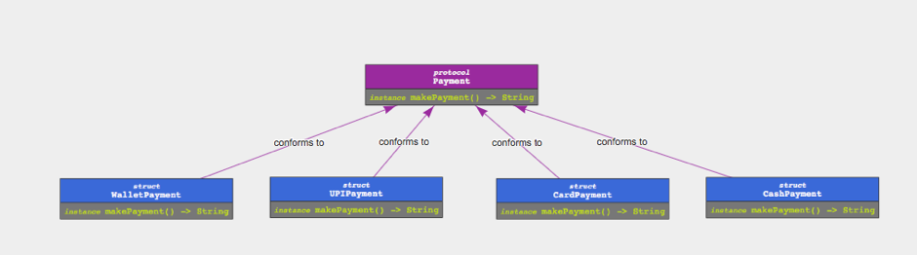
Open and Closed Principle
In simple term, Open for extension but closed for modification. Classes should be open for extending the functionality of the class but should not allow to touch/modify the existing functionality.

Slide 7
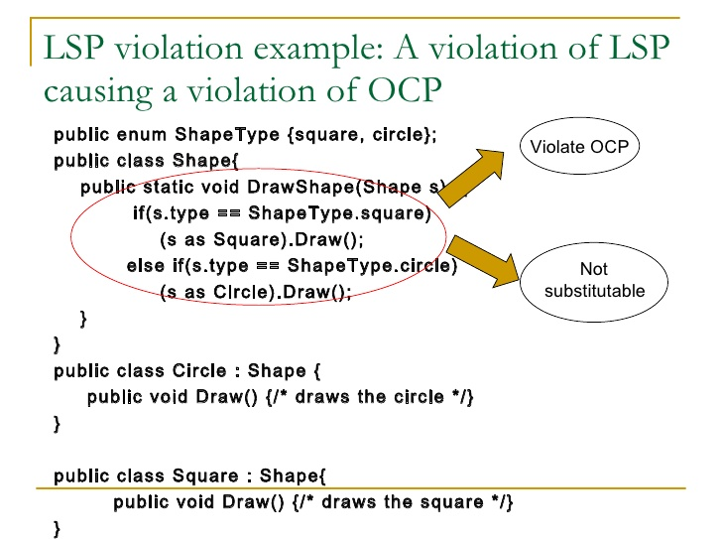
Liskov Substitution Principle
Liskov's notion of a behavioural subtype defines a notion of substitutability for objects; that is, if S is a subtype of T, then objects of type T in a program may be replaced with objects of type S without altering any of the desirable properties of that program.

Slide 8
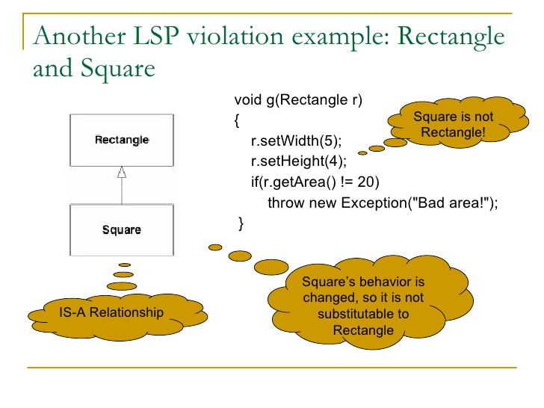

Slide 9
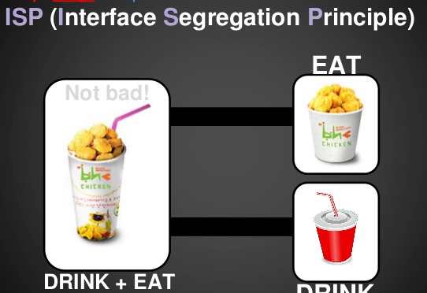
Interface segregation principle
The interface-segregation principle (ISP) states that no client should be forced to depend on methods it does not use. ISP splits interfaces that are very large into smaller and more specific ones so that clients will only have to know about the methods that are of interest to them. Such shrunken interfaces are also called role interfaces. ISP is intended to keep a system decoupled and thus easier to refactor, change, and redeploy.

Slide 10
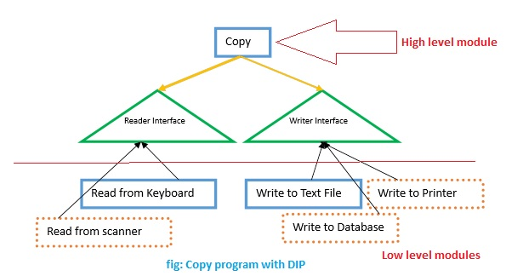
Dependency Inversion Principle
High-level modules should not depend on low-level modules. Both should depend on abstractions.
Abstractions should not depend on details. Details should depend on abstractions.

Slide 11
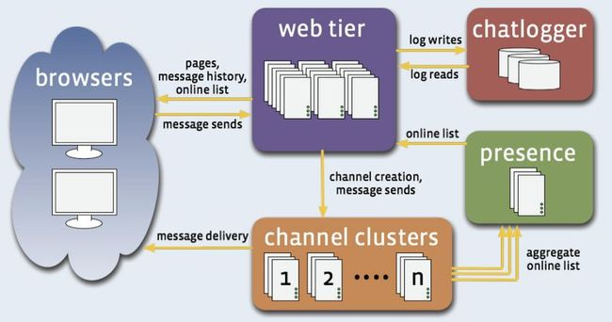
Facebook Erlang
Entity: User, message, channel, friend list.
Public channel is almost like a news feed.
Monotonic read consistency.
SQL for user management and friend list
Non-SQL, such as Kafka for channel or messages.

Slide 12
Design an Elevator

Slide 13
Design an Elevator
Car
How to decide moving direction?
When to respond request, fast elevator or slow one?
When to stop? Open door, close door
Overloaded?
Inner Button
Press, clear
When to ignore
External Button
Request up/down,
How to send request to cars? Or let them figure out themselves?
Building
Display where each car is located.
Only at lobby

Slide 14
Top N error code
There are many logs coming in order of time, each with a timestamp, with granularity as seconds, tell me top N error code in last five minutes.
Follow up
What if logs are not in order of time.
What if no minimum granularity in time stamp.
What if we want to query any time range
We do not need check logs 24 hours ago.

Slide 15
Design Top N error code
If logs are in order of time with granularity
We can use circular buffer, vector<map<int, int>>, every last element contains accumulated count of error code.
If logs are NOT in order of time without granularity
We can use TreeMap (BST), or B+ tree, ordered by time, with error code count.
For massive logs
Page is a good idea, page by fixed time range, say 5 minutes, within page use B+ tree, ordered by timestamp.

Slide 16
Design Tiny URL
Encode long URL to a short one
Hash table, can use database
Base64 encoding

Slide 17
Common Data Structure
Data Structure
Queue and Stack | FIFO or LIFO, no direct access
List | Easy extend, O(1) insert and remove
Hash Table | O(1) access by key
Tree Map | Binary Search, get range, O(1) access minimum, max and next
Trie Tree | Search words when typing
Bucket | Divide and Conquer
B+ Tree | Frequent Update and Search

Slide 18
Max Stack
https://leetcode.com/problems/max-stack/description/

Slide 19
Max Stack
class MaxStack {
private:
map<int, stack<list<int>::iterator>> m_ValueMap;
list<int> m_Stack;
public:
…
};

Slide 20
LRU Algorithm
https://leetcode.com/problems/lru-cache/description/

Slide 21
LRU Algorithm
class LRUCache
{
private:
size_t m_Capacity;
list<pair<int, int>> m_List;
map<int, list<pair<int, int>>::iterator> m_map;
public:
…
};

Slide 22
Flatten 2D Vector
https://leetcode.com/problems/flatten-2d-vector/description/

Slide 23
Flatten 2D Vector
class Vector2D
{
private:
size_t m_Row;
size_t m_Col;
vector<vector<int>> m_Vector;
};

Slide 24
Random Point in Non-overlapping Rectangles
https://leetcode.com/problems/random-point-in-non-overlapping-rectangles/description/

Slide 25
LFU Cache
https://leetcode.com/problems/lfu-cache/description/

Slide 26
LFU Cache
class LFUCache
{
private:
size_t m_capacity;
int m_minFreq;
// map key to the frequency list position
unordered_map<int, pair<int, list<pair<int, int>>::iterator>> m_keyMap;
// map frequency to the value list
unordered_map<int, list<pair<int, int>>> m_freqMap;
public:
...
};

Slide 27
Common Knowledge

Slide 28
Difference Between Abstract and Template
Abstract
Template
Interfaces are explicit and focus on function signatures.
Polymorphism occurs at runtime through virtual functions.
Inheritance is "vertical" and goes down, from the abstract to the more and more concrete. A shape, a triangle, an equilateral triangle.
For template parameters, interfaces are implicit and based on valid expressions.
Polymorphism occurs during compilation through template instantiation and function overloading resolution.
Templates are "horizontal" and define parallel instances of code that knowns nothing of each other. Sorting integers is formally the same as sorting doubles and sorting strings, but those are three entirely different functions.

Slide 29
Difference Between Abstract and Interface
Interface
Abstract
Interface can have only abstract methods
Interface has only static and final variables.
Interface can’t provide the implementation of abstract class.
A Java interface can be implemented using keyword “implements”.
An interface can extend another Java interface only.
Members of a Java interface are public by default
Abstract class can have abstract and non-abstract methods. From Java 8, it can have default and static methods also.
Abstract class can have final, non-final, static and non-static variables.
Abstract class can provide the implementation of interface.
Abstract class can be extended using keyword “extends”.
Abstract class can extend another Java class and implement multiple Java interfaces.
A Java abstract class can have class members like private, protected, etc.

